Slide 1
System and Network Security
Firewalls
MDCSE Group 4
MCN 7103: System and Network Security

Slide 2
Firewalls
A firewall forms a barrier through which the traffic going in each direction must pass. A firewall security policy dictates which traffic is authorized to pass in each direction.
A firewall may be designed to operate as a filter at the level of IP packets or may operate at a higher protocol layer.
Firewalls can be an effective means of protecting a local system or network of systems from network-based security threats while at the same time affording access to the outside world via wide area networks and the Internet
MDCSE Group 4
MCN 7103: System and Network Security

Slide 3
The Need for Firewalls
Information systems in corporations, government agencies, and other organizations have undergone a steady evolution. The following are notable developments:
  Centralized data processing system, with a central mainframe supporting several directly connected terminals
  Local area networks (LANs) interconnecting PCs and terminals to each other and the mainframe.
  Premises network, consisting of several LANs, interconnecting PCs, servers, and perhaps a mainframe or two.
  Enterprise-wide network, consisting of multiple, geographically distributed premises networks interconnected by a private wide area network (WAN)
  Internet connectivity, in which the various premises networks all hook into the Internet and may or may not also be connected by a private WAN
MDCSE Group 4
MCN 7103: System and Network Security
Notes:
Internet connectivity is no longer optional for organizations. The information and services available are essential to the organization. Moreover, individual users within the organization want and need Internet access, and if this is not provided via their LAN, they will use dial-up capability from their PC to an Internet service provider (ISP). However, while Internet access provides benefits to organization, it enables the outside world to reach and interact with local network assets. This creates a threat to the organization. While it is possible to equip each workstation and server on the premises network with strong security features, such as intrusion protection, this may not be sufficient and in some cases is not cost-effective. Consider a network with hundreds or even thousands of systems, running various operating systems, such as different versions of UNIX and Windows. When a security flaw is discovered, each potentially affected system must be upgraded to fix that flaw. This requires scaleable configuration management and aggressive patching to function effectively. While difficult, this is possible and is necessary if only host-based security is used. A widely accepted alternative or at least complement to host-based security services is the firewall.The firewall is inserted between the premises network and the
Internet to establish a controlled link and to erect an outer security wall or perimeter.The aim of this perimeter is to protect the premises network from Internet-based attacks and to provide a single choke point where security and auditing can be imposed. The firewall may be a single computer system or a set of two or more systems that cooperate to perform the firewall function.
The firewall, then, provides an additional layer of defense, insulating the internal systems from external networks. This follows the classic military doctrine of “defense in depth,” which is just as applicable to IT security.

Slide 4
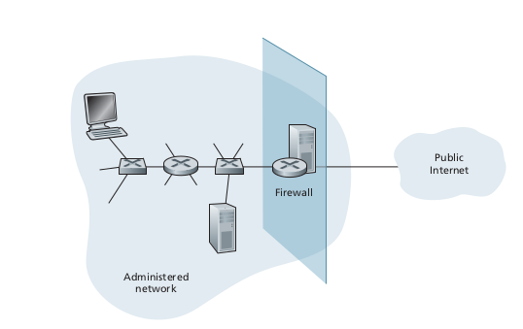
Characteristics of firewalls

Slide 5
Characteristics of firewalls
All traffic from outside to inside, and vice versa, passes through the firewall. As show in the figure, sitting squarely at the boundary between the administered network and the rest of the internet.
Large organizations may use multiple levels of firewalls or distributed firewalls.
Locating a firewall at a single access point to the network, makes it easy to manage and enforce a security-access policy.

Slide 6
Characteristics of firewalls
Only authorized traffic as defined by the local security policy , will be allowed to pass.
The firewall can restrict access to unauthorized traffic.
Firewall is immune to penetration, it can be compromised if not properly installed and configured hence providing a false sense of security.

